Slide 1
Maze Generation
Nathaniel Graham and Kelly Olivier

Slide 2


System
OS : Ubuntu
Release: 19.10 (Eoan Ermine) 64-bit
Kernel: Linux 5.3.0-23-generic x86
Version: MATE 1.22.2
RAM: 11.5 Gb
Processor: Intel Core i5-8265U @ 1.60GHz x 8

Slide 3
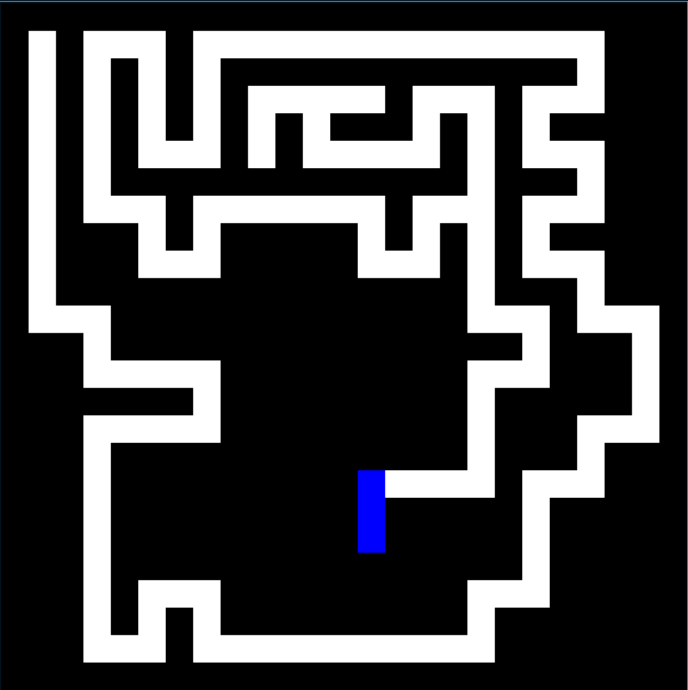
Recursive Backtracker
Choose a starting point in the field (upper left)
Randomly choose a wall and delete it, but only if the adjacent cell has not been visited yet. This becomes the new current cell
If all adjacent cells have been visited, back up to the last cell that has uncarved walls and repeat
The algorithm ends when we’ve backed all the way up to the starting point
Average creation time: 0.000634 sec

Slide 4
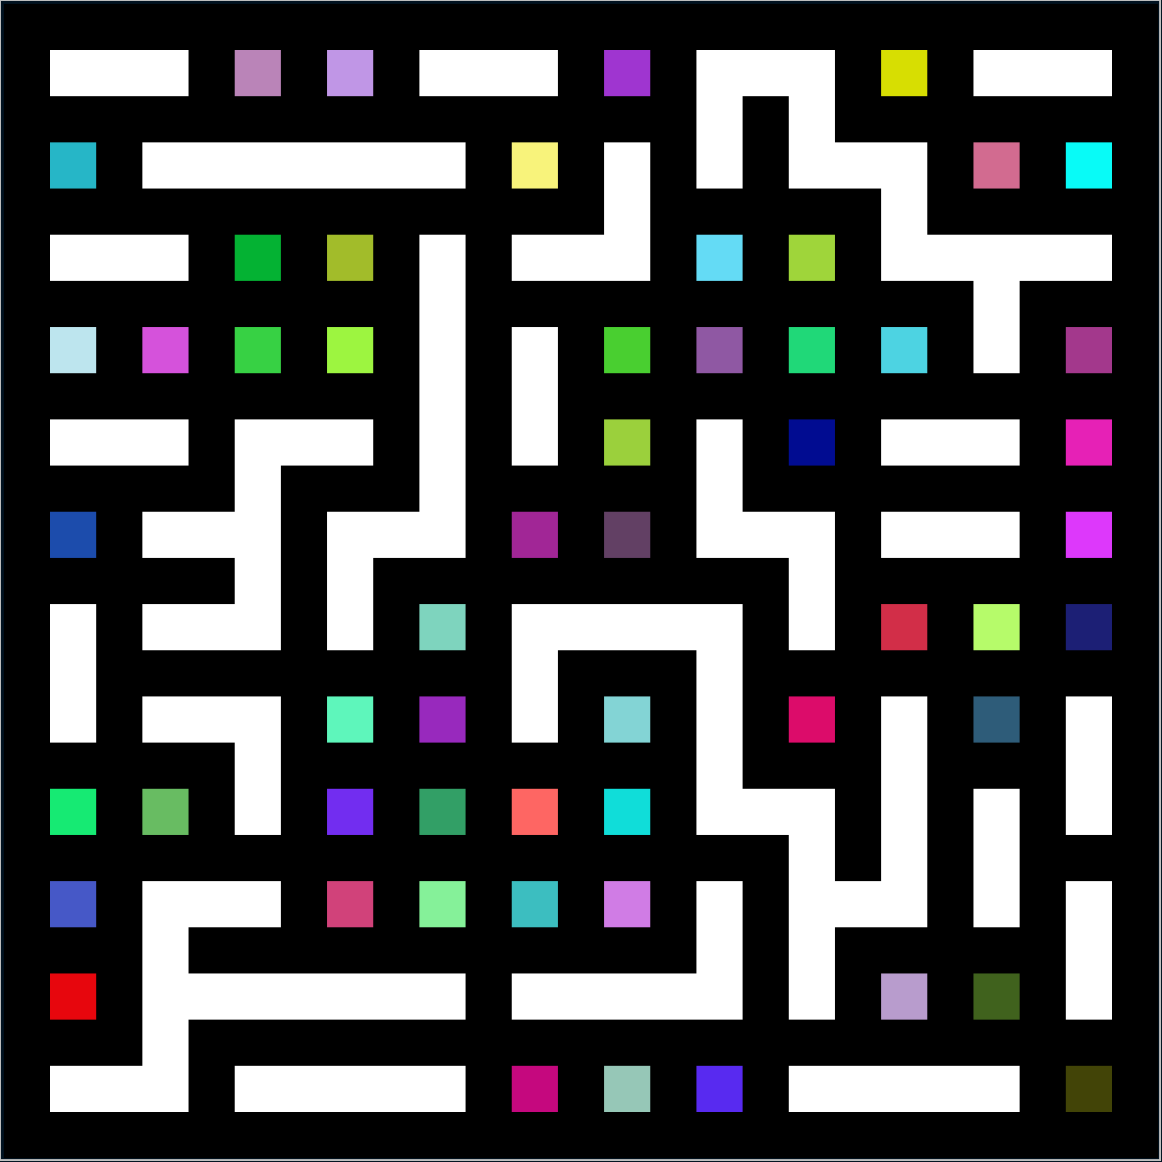
Kruskal’s Algorithm
Create a set containing every edge
Select a random edge. If the edge connects two disjoint sets, merge the sets. Otherwise, discard the edge.
Repeat until there are no more edges left.
Fun fact:
You can seed Kruskal’s with your name to create a maze that spells out your name
Average creation time: 0.000895 sec

Slide 5
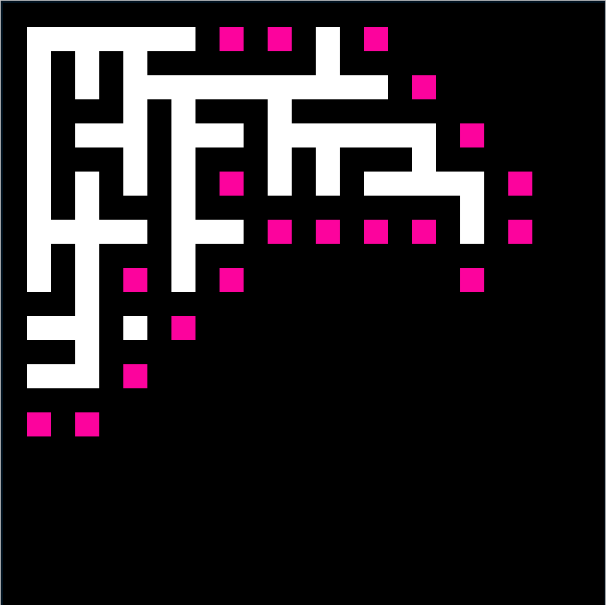
Prim’s
Begin by adding a start node to the frontier set
Choose a node from the frontier set and mark it as visited.
Check every neighbor of that node
Add neighbors that are already visited to a pool
Add neighbors that are not yet visited to the frontier set
Connect the current node to a random neighbor from the pool
Average creation time: 0.001961 sec

Slide 6
Solution Methods
Recursive Backtracker
A*
Not the same solution every time, since the choice of which direction to turn at each intersection is random
We noticed, but haven’t extensively tested, that RB is better on Prim’s and Kruskal’s
Always the same solution every time, the “next move” is determined by which of its “fronts” are closest to the destination
We noticed, but haven’t extensively tested, that A* is better on RB than on Prim’s/Kruskal’s

Slide 7
Major Challenges
Determining the most efficient data structures to use
Kruskal’s – Finding the best way to keep track of the sets and checking for adjacency of nodes
Optimizing for edge removal (based on picking the right DS)
Getting colors to properly show up and persist for various algorithms when gifs were created

Slide 8
Future Expansions
Expanding it to also be a maze-art generator using name/word seeds with Kruskal’s algorithm
Non-square mazes
Adding in more solving/creation algorithms

Slide 9
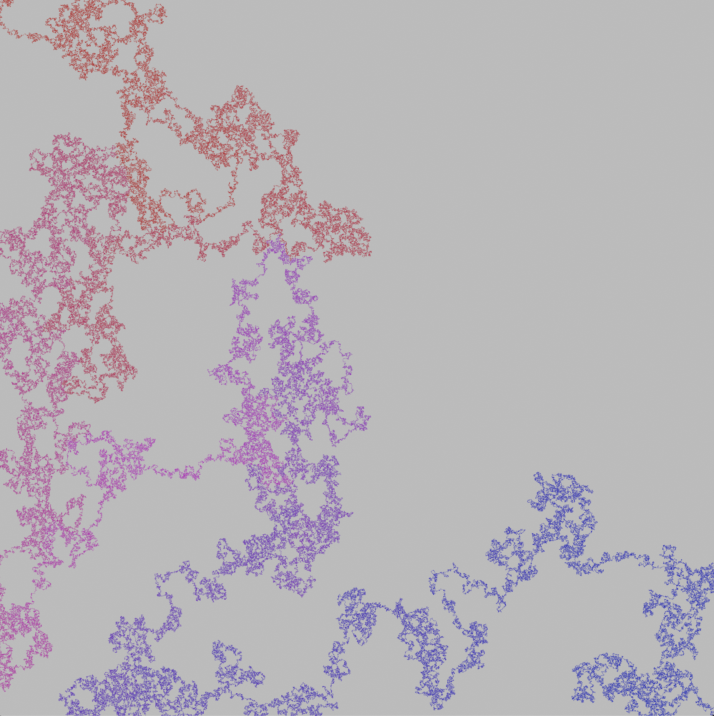
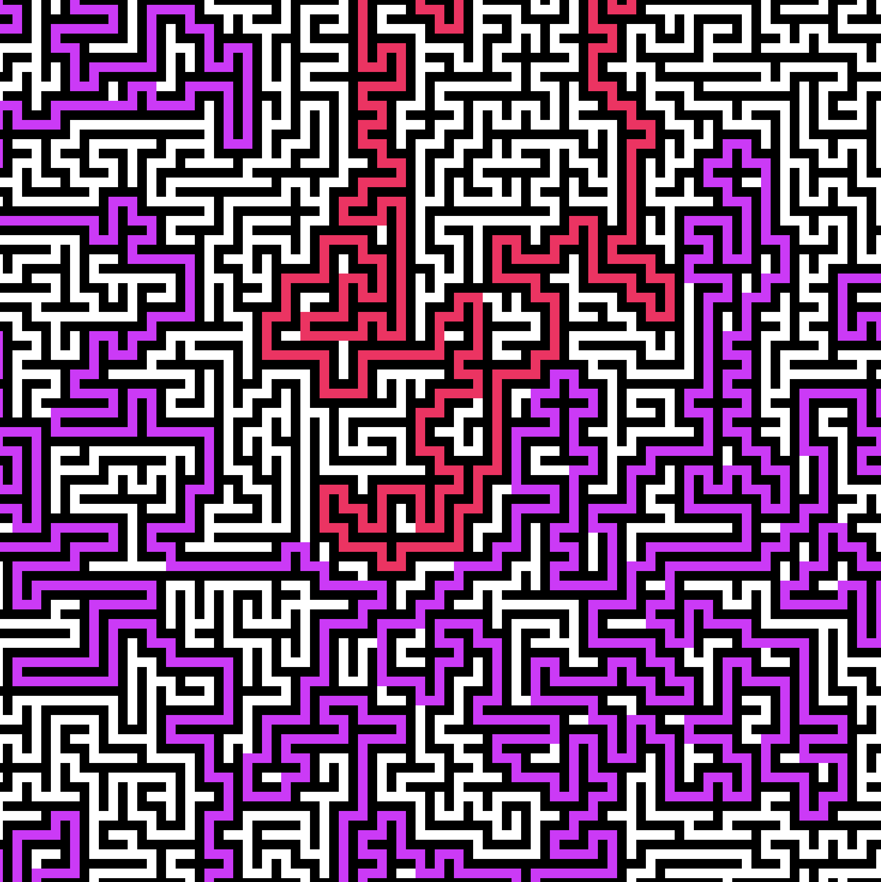
Questions?
This is a 10,001 x 10,001 pixel RB-generated maze, solved by A*
(Stretched to fit to the slide)

